Slide 1
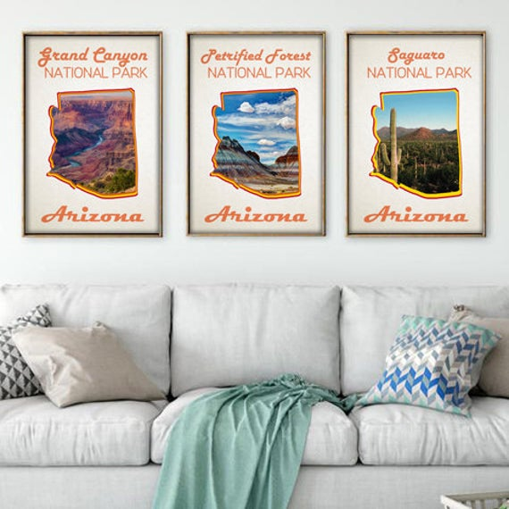
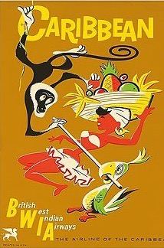
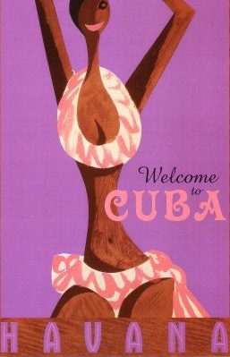
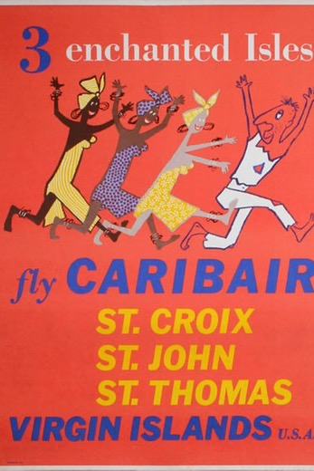
Buying Bodies:
Exoticism in Mid-Century Caribbean Travel Posters and Sex Tourism Impacts
Laura Bishop
Notes:
Hello Everyone! My title, Buying Bodies: Exoticism in Caribbean Mid-Century Travel and Sex Tourism Impacts is still a working title. This research work is directly related to my exhibition work, so there is some desire on my part to have these themes cohesive— but it’s early, right? Honestly I have been down several rabbit holes, and there is flood of information regarding colonialism, neocolonialism, orientalism, subjugation of women and the feminist theory regarding this marketing work, so there is still much to do. I hope this presentation gives a fairly clear overview of the research I am trying to accomplish, even though I am still wading through a significant amount of information.

Slide 2
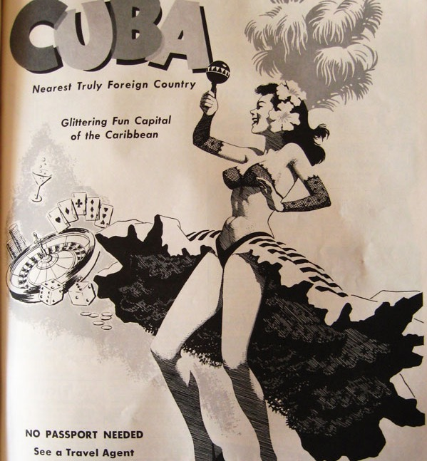
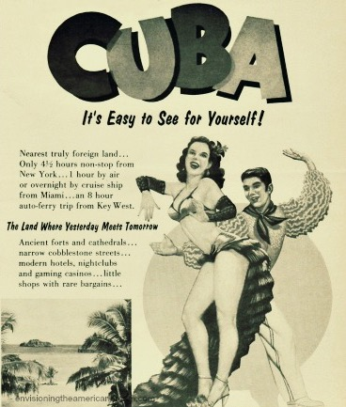
“For decades destinations [in the Caribbean] have been saddled with images of smiling natives, often [scantily clad], shuffling under limbo bars with frothy fruit and rum drinks, much to the delight of the world’s jet setters…”
–Quoted from Catherine Palmer’s Essay: Tourism and Colonialism
Notes:
These marketing poster images, created by advertising executives during the boom of mass tourism in United States and Europe, still perpetuated today, create a false sense of reality and promote exoticism and fantasy in the minds of traveler.
I am working towards

Slide 3
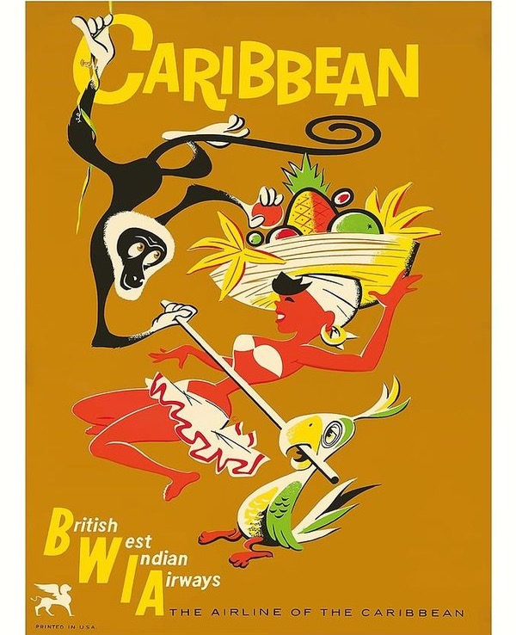
Research Questions: What are we looking at?
What, exactly, do these images represent? And, how have these classic advertisements perpetuated problematic ideas of fantasy and the exotic impacting the commoditization of humans in the sex tourism trade?
Notes:
Hung in homes and businesses and prized for their colorful, aesthetic value, vintage Caribbean travel posters of the mid 20th century are currently sold by the thousands through novelty art retailers and online vendors. These posters are largely viewed as decorative accoutrements; for some, they are reminiscent of a past trip or act as a visual cue for desired travel goals. However, while seemingly innocuous to the casual viewer, these posters can be seen as idealistically transforming our notions of “the foreigner”, through a process of othering while intersecting notions of power and human commodity in the sex tourism trade. While this paper does not seek to condemn the practice of sex tourism, it does aim to research and illustrate how these images have shaped the historical, political and social implications of tourism dependent economies and their exploited identity through the ethical lens of Julia Kristeva’s theories of cultural abjection and conceptualization. Which leads to the question: What, exactly, do these images represent? And, how have these classic posters perpetuated problematic ideas of fantasy and the exotic impacting the commoditization of humans in the sex tourism trade?

Slide 4
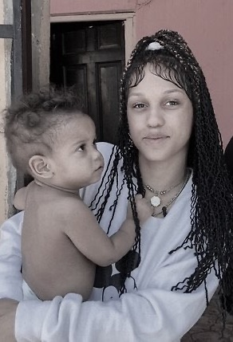
1
2
3
Notes:
There are three things I’d like to cover in the presentation:
First, I’d like to overview a little about tourism and sex tourism in the Caribbean: The (non) data and how it continues to thrive and its current impact and power over local economies. I think this is very relevant information in the discourse of these iconic images.
Second, dive into the image of analysis itself by asking — what are we looking at? How was it influenced? How is the imagery related to sex tourism? Why are these images still important?
Third, who (meaning theorists) support the ethical argument? What are they theorists saying?
Wrap up with: What are the next steps? Where am I going form here? What are the struggles?
At the end I have added the bibliography as well — which of course continues to grow.

Slide 5
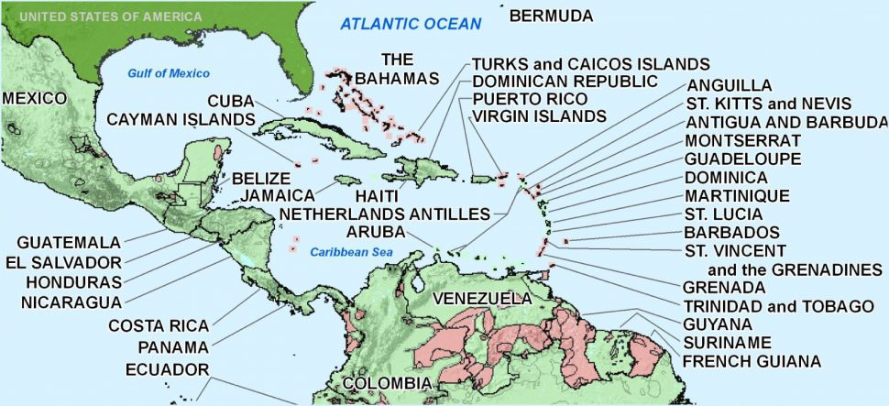
Tourism is one of the Caribbean’s oldest businesses, however, all instances of colonialism are unique; but share common characteristics (N. Thomas)
Notes:
The Caribbean, with few employment opportunities and sub-standard living conditions, has women and girls flocking to the densely-populated tourist areas in search of sexual employment and although illegal (not enforced — and interestingly, its the workers that are ticketed or jailed, and not the tourist), sex tourism has become a major component of the Caribbeans successful tourism industry. While its difficult to obtain exact statistics on the number of sex tourists and sex workers in the Caribbean as a whole, the area has seen female and child prostitution become a major income generator, perpetuating the an unbalanced global economy for the region. Tourists from all over the world can book what are thinly disguised weekend sex tours where men can command women and girls with the same ease as ordering a cocktail.
I specifically chose the Caribbean for a couple of reasons, first, because I have traveled there myself and felt a connection to the issue at hand. Secondly, I chose this area because I felt due to its geographic proximity, some other viewers might also share a connectivity.
Although there is growing evidence that women seeking men and same sex commodity is growing as evidenced and marketed in many places such as contemporary movies— some of you might remember the movie, How Stella Got Her Groove Back, that’s another whole paper, right? (Hey, maybe I should add that to my list of COVID19 binge?) But, for the purposes of this paper, I will relate the imagery in my analysis to the most common type of sex tourism — men seeking women.
Because of the Caribbean’s clear dependence on tourism, the Caribbean continues to be a playground for those jet setters in search of cheap cigars, rum and prostitutes, just as it was during the golden age of mass tourism— and these images continue to propagate that fantasy even today.

Slide 6
Artifact:
British West Indies Airways
“The Airline of the Caribbean”
BWIA travel poster circa 1960 as direct flights began to/from US and Europe
Ambiguous skin tone
Bikini top | fruit bowl hat

Slide 7
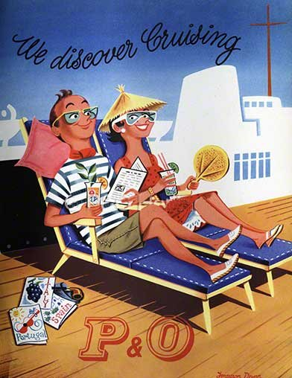
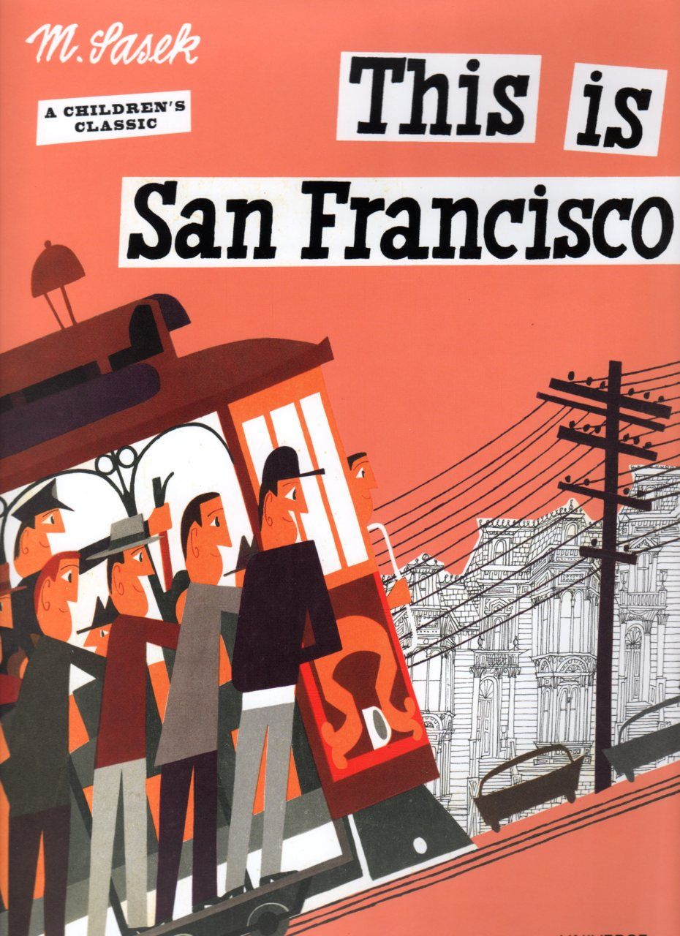
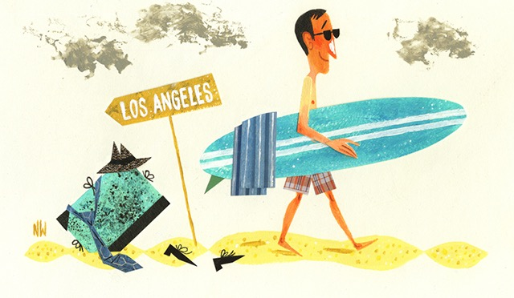
Mid-Century Travel
Graphic Design Influence
Ferguson Dewar (far left)
Miroslav Sasek (left, bottom)
Notes:
Notable Mid-Century Graphic designers:
Information regarding Ferguson Dewar is very thin, but his early work as a freelance artist in the 1950s included illustrations for articles in Woman's Own magazine, packaging artwork for Hollands Toffees and advertisements for the P&O cruise line and Murraymints.
Czech illustrator Miroslav Sasek‘s set of reissued children’s travel books After publishing the first of his This Is… series in 1959, Sasek continued to capture the essence of worldly destinations like London, Israel, Munich, San Francisco and Hong Kong, with his notable midcentury style.
These influences are significant in that the artists generating the images for travel are primarily derivative of Western or European ideation— white and male, looking to define the exotic of another land, and perpetuating the travel industry’s vested interests in the status quo.

Slide 8
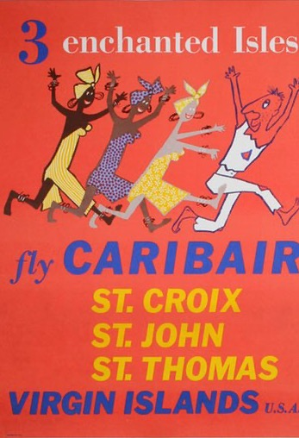
Why are these posters significant in sex tourism?
Collected, purchased even today and reproduced as art imagery for sale
Notes:
An original BWIA poster is currently for sale at The Vintage Poster for $970. Prints and some reimagined imagery can be purchased for anywhere between $15 and $50, depending on size and framing options.
While Sex Tourism is a global issue, it might be surprising to some that the Caribbean has one of the highest rates of sex tourism globally. As stated previously, this industry of sex work in the Caribbean is extremely profitable, and obviously the tourist market's role in sex tourism raises questions about how we sell and market images of Caribbean culture within the tourism industry.
These images of the past continue to influence the images of the present— and these images are in important indicator of how to define, encounter and relate to a population. These images are a powerful force in the creation and continued contemporary myths of identity and confirms for Western and European culture the stereotypes of the exotic —and erotic fantasies. Once they are accepted as fact, these images are used by the tourism industry to promote various destinations and create an illusion. These myths and stereotypes describing local populations provide the tourist with “legitimate” reasons for their actions.

Slide 9
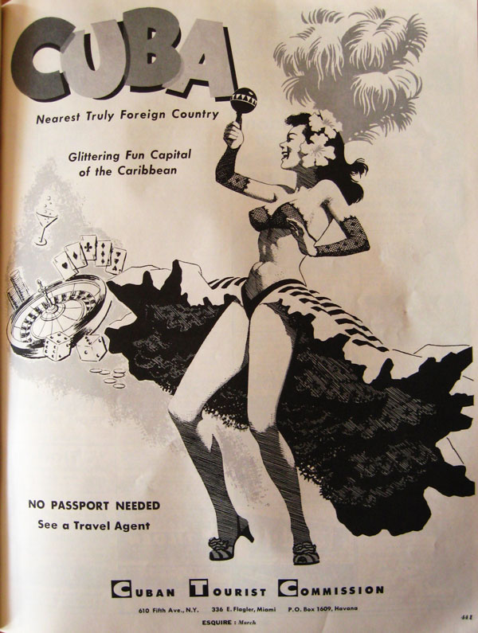
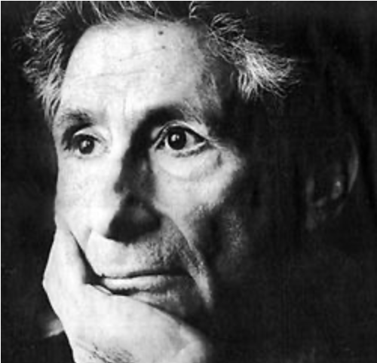
Theoretical Filters: Edward Said
Said, in reference to orientalism discusses at length how colonialism places the Westerner in a state of positional superiority— so the “will” towers over others— “it’s will to power, and will to govern…”
Notes:
To add to that:
These fantasies are complicated by a range of framings, drawing on history to portray the islands as a sexually permissive, pleasurable, seductive and sensuous destination, pervasive not only to US, but also to the colonized themselves. Issawi writes: “[people] are always inclined to attribute perfection to those who have defeated and subjugated them. This can be part of an explanation as to why the practice continues to grow at the hand of not just Westerners, but the locals as well. While this isn’t to say the locals are to blame, but rather, much like the abused, perhaps sometimes it’s easier to put up with it than to fight it. And the rhetoric of this image, in many subjugate ways continues the discourse of domination.

Slide 10
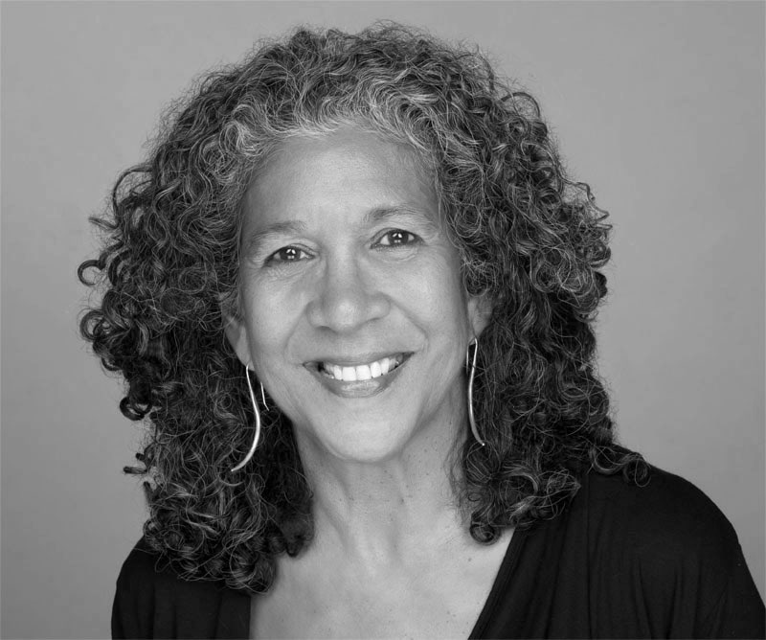
Influencers: Kamala Kempadoo
“Certainly, Caribbean vacations are often marketed with the promise of sexual pleasure and for many Western male tourists are intimately entwined with notions of eroticized and sexually available local women.”
Notes:
Kamala Kempadoo is Associate Professor in Social Science at York University, Canada. She is the author of Sexing the Caribbean: Gender, Race and Sexual Labor (2004) and Global Sex Workers: Rights, Resistance, and Redefinition (1998).

Slide 11
Conclusion
These classic travel images of the past continue to be powerful force.
Notes:
My argument that these images perpetuate the sex tourism trade in a negative way are in based in the perpetual circle of power and domination of cultures. The more economies rely on tourism, through the sex trade and women are its main commodity, the more likely they perpetuate their own prison— as there is no other way to sustain, and this becomes a cycle. This imagery of the exotic perpetuates idealism of exotic beauty with power, conquest and domination at the forefront.
Where so I go from here? Keep researching. Keep finding more nuggets of history and, certainly get some good feedback.
Thanks everyone!

Slide 12
